Slide 1




NEXT GEN EMPLOYABILITY PROGRAM
Creating a future-ready workforce
Team Members
College Name
Student Name : AJAYROSHAN R
Student ID : au311121205003
Loyola ICAM College of Engineering and Technology

Slide 2

CAPSTONE PROJECT SHOWCASE
Project Title
Music Web Application using Django Framework
Abstract | Problem Statement | Project Overview | Proposed Solution | Technology Used | Modelling & Results | Conclusion

Slide 3
Abstract
In the digital age, music consumption has become more diverse and personalized than ever. To cater to the evolving needs and preferences of music enthusiasts, the development of a sophisticated web application is essential. "Harmonize" is a cutting-edge music web application built upon the Django framework, designed to provide users with a seamless and immersive musical experience.
Harmonize offers a range of features aimed at enhancing user engagement and satisfaction. The application allows users to discover new music through personalized recommendations based on their listening history, preferences, and trends. Leveraging advanced algorithms and machine learning techniques, Harmonize analyzes user behavior and musical patterns to curate playlists tailored to individual tastes.
Furthermore, Harmonize enables users to create and share playlists with friends and the wider community, fostering collaboration and social interaction among music enthusiasts. Users can explore a vast library of tracks across genres, artists, and albums, with intuitive search and filtering options to facilitate effortless navigation.
One of the standout features of Harmonize is its emphasis on community engagement and user-generated content. Users can contribute to the platform by rating songs, writing reviews, and participating in discussions, creating a dynamic and vibrant music community.
Moreover, Harmonize prioritizes user experience and accessibility, with a sleek and responsive interface that adapts seamlessly to various devices and screen sizes. The application employs robust security measures to safeguard user data and privacy, ensuring a safe and trustworthy environment for music exploration and interaction.
In summary, Harmonize represents the next generation of music web applications, combining innovative technology with user-centric design to deliver an unparalleled listening experience. Whether discovering new music, connecting with fellow music lovers, or simply enjoying favorite tracks, Harmonize offers a comprehensive and immersive platform for all music enthusiasts.
Source :

Slide 4
Problem Statement
Despite the abundance of music streaming platforms available today, there remains a need for a sophisticated and user-centric music web application built on robust technology to address several key challenges faced by music enthusiasts:
Fragmented Music Discovery: Many music streaming services offer extensive libraries, but users often struggle with discovering new music tailored to their specific tastes and preferences. Existing recommendation algorithms may lack personalization and fail to adapt to individual listening habits effectively.
Limited Social Interaction: While some platforms incorporate social features such as sharing playlists or following artists, there's often a lack of meaningful community engagement and collaboration among users. Many music enthusiasts desire a more interactive and social experience centered around music exploration and discussion.
Suboptimal User Experience: Some music web applications suffer from clunky interfaces, slow performance, and inadequate search functionalities, leading to frustration and inefficiency for users. Ensuring a seamless and intuitive user experience across various devices and screen sizes is crucial for user satisfaction and retention.
Privacy and Security Concerns: With the increasing digitization of music consumption, ensuring the privacy and security of user data is paramount. Instances of data breaches and privacy violations raise concerns among users regarding the protection of their personal information and listening habits.
Addressing these challenges requires the development of a comprehensive music web application that leverages advanced technology, personalized recommendation algorithms, robust social features, and a user-centric design approach. Such an application should prioritize seamless music discovery, foster community interaction, optimize user experience, and ensure the highest standards of privacy and security.
Source :

Slide 5
Project Overview
The project aims to develop a music web application using the Django framework, titled "Harmonize." Harmonize will offer users a personalized and interactive platform for discovering, sharing, and enjoying music. The application will focus on addressing the following key aspects:
User Authentication and Profile Management: Users will be able to create accounts, log in securely, and manage their profiles. Personalization will be emphasized, allowing users to customize their music preferences and settings.
Music Discovery: Harmonize will feature advanced recommendation algorithms to suggest music based on users' listening history, preferences, and trends. Users will have access to a vast library of tracks spanning various genres, artists, and albums, with intuitive search and filtering options for effortless navigation.
Social Interaction: The application will prioritize community engagement by enabling users to create and share playlists, rate songs, write reviews, and participate in discussions. Social features will facilitate collaboration and interaction among music enthusiasts, creating a dynamic and vibrant music community within the platform.
User Experience Optimization: Harmonize will prioritize a seamless and intuitive user experience across desktop and mobile devices. The application will feature a sleek and responsive interface, ensuring easy navigation and efficient music exploration.
Privacy and Security: Robust security measures will be implemented to safeguard user data and privacy. Harmonize will adhere to the highest standards of data protection, mitigating risks associated with data breaches and privacy violations.
The development process will involve iterative design, implementation, testing, and refinement to ensure that Harmonize meets the needs and expectations of its users. Collaboration with beta testers and feedback collection will be integral to improving the application's features and user experience. Ultimately, Harmonize aims to revolutionize the way users discover, share, and enjoy music, providing a comprehensive and immersive platform for music enthusiasts worldwide.
Source :

Slide 6
Proposed Solution
The proposed solution is to develop "Harmonize," a Django-based music web application that addresses the shortcomings of existing platforms by offering a personalized, interactive, and feature-rich music experience.
Key Features:
Personalized Music Discovery: Harmonize will employ sophisticated recommendation algorithms to suggest music tailored to each user's preferences, listening history, and trends. Users will have access to curated playlists, personalized recommendations, and advanced search and filtering options to discover new music effortlessly.
Social Interaction and Community Engagement: Harmonize will prioritize social features, allowing users to create and share playlists, rate songs, write reviews, and participate in discussions with fellow music enthusiasts. The platform will foster collaboration and interaction, creating a vibrant and engaged music community.
User Profile Management: Users will be able to create accounts, log in securely, and manage their profiles. Personalization options will enable users to customize their music preferences, create playlists, and track their listening history.
.
Source :

Slide 7
Intuitive User Interface: Harmonize will feature a sleek and responsive interface designed for ease of use across various devices and screen sizes. The application will prioritize intuitive navigation, efficient music exploration, and seamless user interaction.
Privacy and Security: Robust security measures will be implemented to safeguard user data and privacy. Harmonize will adhere to best practices in data protection, ensuring the confidentiality and integrity of user information.
Development Approach:
The development of Harmonize will follow an iterative process, starting with requirements gathering, design, and prototyping. Agile development methodologies will be employed to facilitate continuous feedback and iteration. Regular testing and quality assurance will ensure the stability, reliability, and performance of the application.
Furthermore, collaboration with beta testers and user feedback collection will be integral to refining and enhancing Harmonize's features and user experience. Continuous updates and improvements will be delivered to ensure that Harmonize remains at the forefront of music web applications.
Source :

Slide 8


Technology Used
Front-end
Back-end
Source :

Slide 9

Login Page

Slide 10
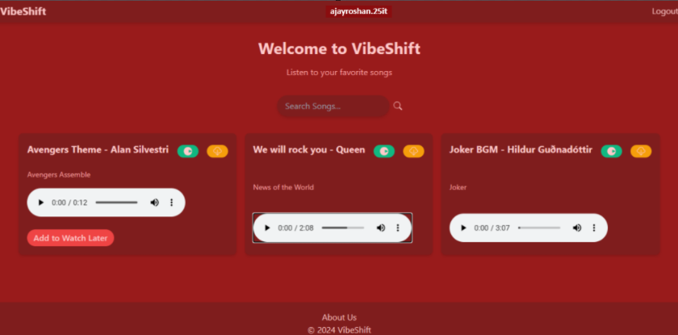
About-Us-Page

Slide 11
Future Enhancements:
Enhanced Recommendation Engine: Continuously refining and improving the recommendation algorithms to provide even more accurate and personalized music suggestions based on user feedback, social interactions, and real-time listening habits.
Collaborative Playlists: Introducing collaborative playlist features that allow multiple users to contribute and edit playlists together in real-time, fostering collaboration and creativity among friends and music communities.
Live Streaming and Events: Integrating live streaming capabilities for music events, concerts, and DJ sets, allowing users to experience live performances and exclusive events directly within the Harmonize platform.
Integration with Music Events and Festivals: Partnering with music events and festivals to provide exclusive content, ticket sales, and interactive experiences, creating a seamless connection between online and offline music experiences.
Artist Engagement Tools: Providing tools and features for artists to interact with fans, share exclusive content, host Q&A sessions, and promote their music directly within the Harmonize platform, fostering a stronger connection between artists and their audience.
Music Education Resources: Curating educational resources, tutorials, and articles related to music theory, production techniques, and industry insights, empowering users to deepen their understanding and appreciation of music.
Gamification Elements: Incorporating gamification elements such as challenges, achievements, and leaderboards to incentivize user engagement, exploration, and discovery within the Harmonize community.

Slide 12
Conclusion
In conclusion, Harmonize represents a groundbreaking solution in the realm of music streaming platforms, leveraging the Django framework to provide users with a personalized, interactive, and immersive music experience. By addressing the limitations of existing platforms and incorporating innovative features, Harmonize aims to revolutionize the way users discover, share, and enjoy music.
Throughout the development process, the Harmonize team remains committed to prioritizing user feedback, continuous improvement, and technological innovation. With a strong focus on personalization, social interaction, intuitive user experience, and data privacy, Harmonize sets itself apart as a leader in the music streaming industry.
As Harmonize evolves and incorporates future enhancements, it will continue to redefine the standards of music streaming platforms, catering to the diverse needs and preferences of music enthusiasts worldwide. Whether it's discovering new music, engaging with fellow music lovers, or connecting with favorite artists, Harmonize offers a comprehensive and enriching music experience that transcends boundaries and fosters a vibrant global music community.
Source :

Slide 13
Thank You!
Notes:
Thank You !!

